Slide 1

Poornima Institute of Engineering & Technology
TEAM NAME: ENCODERS
PROJECT ID: 8CS PR 2018_19_13
STUDENTS NAME:
1. Aditya Kr. Sharma
2. Deepti Yadav
Project Guide By: Prof. (Dr.) Praveen Gupta
Department of Computer Engineering PIET , Jaipur
QUICKQUIZ

Slide 2
Vision of Department
Department of computer engineering shall create an environment in which new ideas, research and technology grows and form which technocrats and innovators of tomorrow come forward to face the global challenges. It aims at being recognized globally as role model and be a part of substantial natural resources.

Slide 3
Mission of Department
To develop competent professional with innovative mind set, problem solving, design and implementation skills through excellent under graduate education.
To provide platform to students so that they can expertise themselves as a computer professional, entrepreneurs or as a manager while fulfilling their ethical and social responsibility in a globally competitive environment.
To contribute significantly to the research and discovery of new arenas of methods and knowledge in the field of computer engineering.

Slide 4
Index
Objectives
Introduction
Product Backlog
Sprint Backlog-I
Sprint Backlog-II
Sprint Backlog-III
Sprint Backlog-IV
Results
Conclusion and Future Scope

Slide 5
Product Backlog
The flow of project is converted into the form of product backlog to make the process easier into divided tasks and estimated time.
There are 2 types of users in this project-
User
Database admin

Slide 6
Objective
The main objective of “Quiz Contest” is to facilitate a use friendly environment for all users and reduces the manual effort. The functional requirements include to create users that are going to participate in the quiz, automatic score and report generation and administrative tasks like add, delete, update for admin privilege users.

Slide 7
Introduction
quiz is providing quiz facilities to the user. It reduces the time complexity and the space complexity. We can access the app online .We can access any time anywhere. It reduces the paper work. It is very useful for the students. Students can attempt all type of quizzes. He can see score after the submission of exam and also see the no of wrong and right questions.

Slide 8
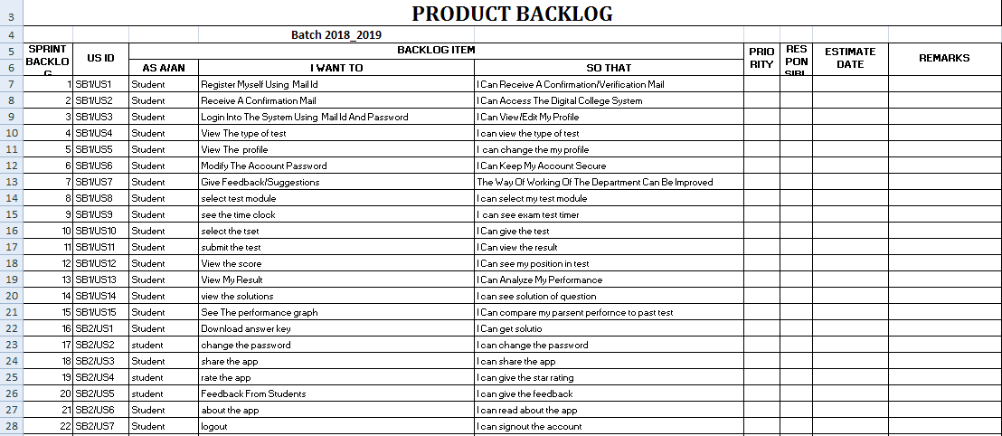
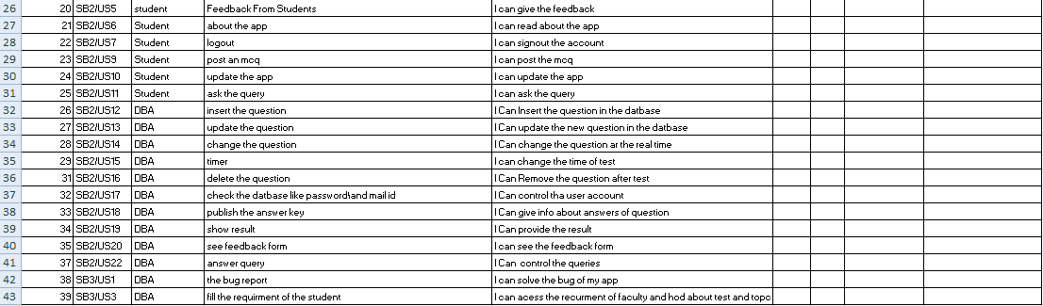

Slide 9
Sprint Backlog -1
In this phase all the perquisites for the project are gathered.
Search for other relevant solutions for the project analysing the similar projects.
Then a web form is developed to take the details of user.
Design a database schema for the project and create databases to store the data of each user. Read about the concepts and methods.

Slide 10
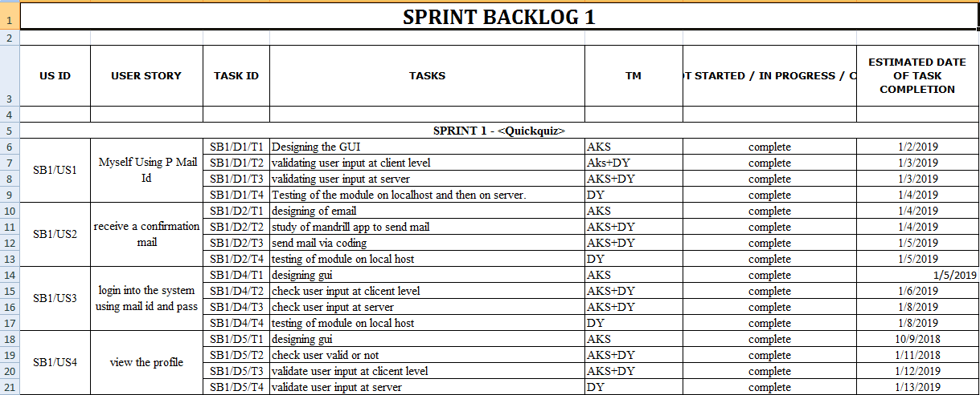
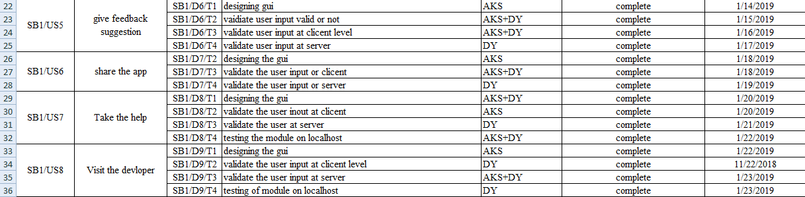

Slide 11
Sprint Backlog -2
In this phase we design the login and registration page for the user.
We write the java code for the login page and the registration page and connect it to java xml file.
Now user can log in into the app with valid password and the user name.

Slide 12
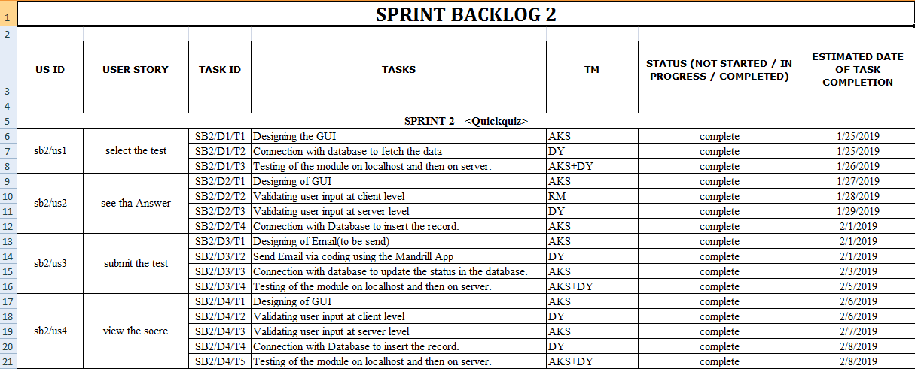
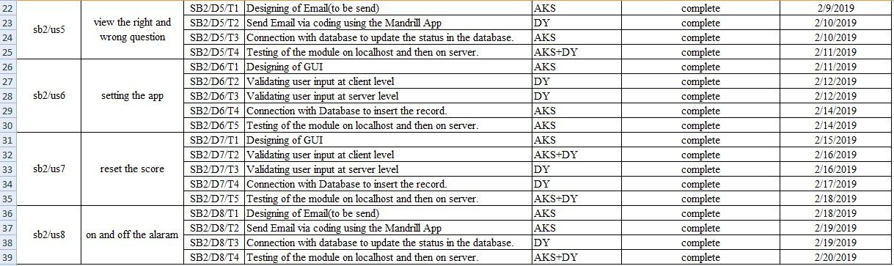

Slide 13
Sprint Backlog -3
In this phase we develop the profile page for the user page .
We design the xml page layout for the profile page.
We write the code for the java code for the user profile page.
Now user can see different type of detail like name, high score, share, feedback, setting. .

Slide 14
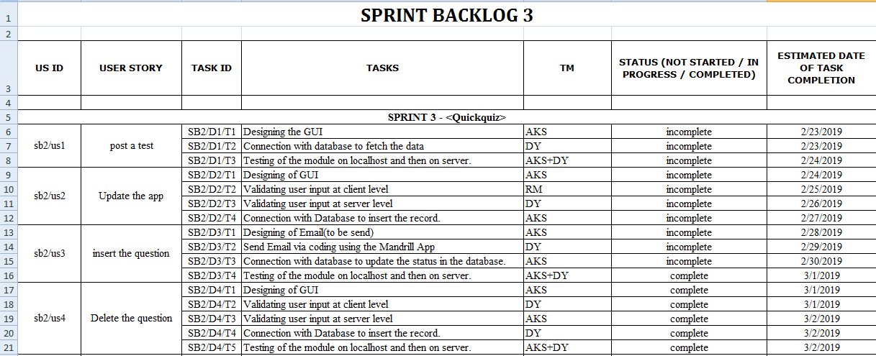
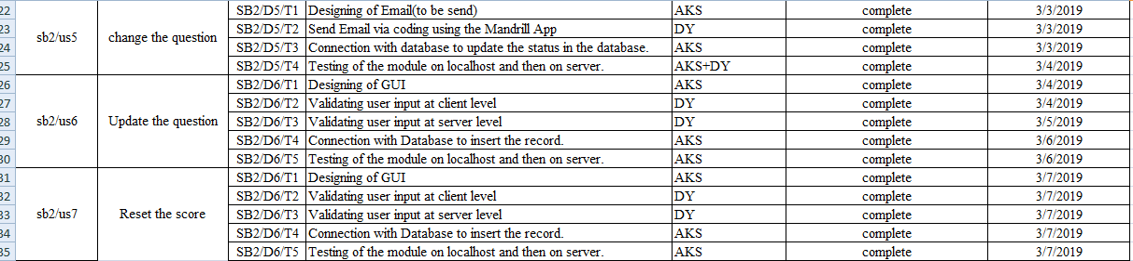

Slide 15
Sprint Backlog -4
In this phase we make the database for whole project. It is sql lite database which is local database of android studio.
user can attempt the different type of quiz like english, maths, computer, sports, science.
He can see score after the submission of exam and also see the no of wrong and right questions.
Implement it for all users.

Slide 16
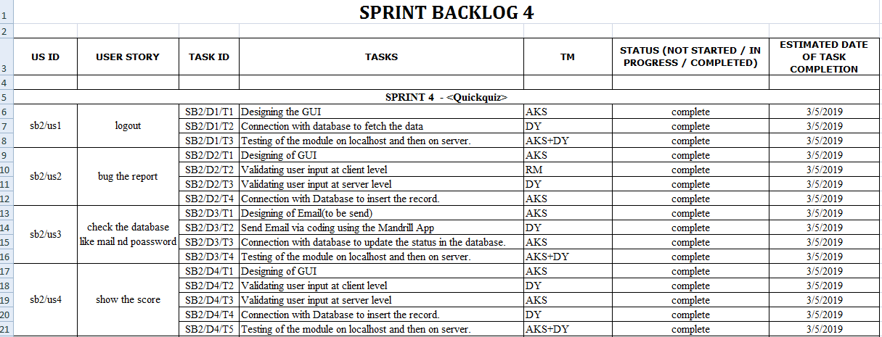
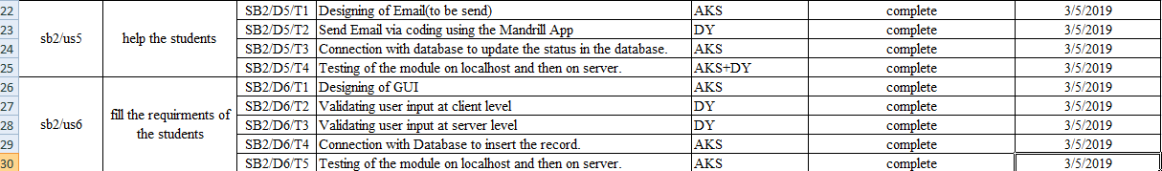

Slide 17
Results
We have successfully developed the application for signature authentication. This application provides a hassle free authentication without physical interaction with the device. There are various stages through which it is developed and last a complete project including graphical user interface is developed.
This project is developed to identify the forged signature.

Slide 18
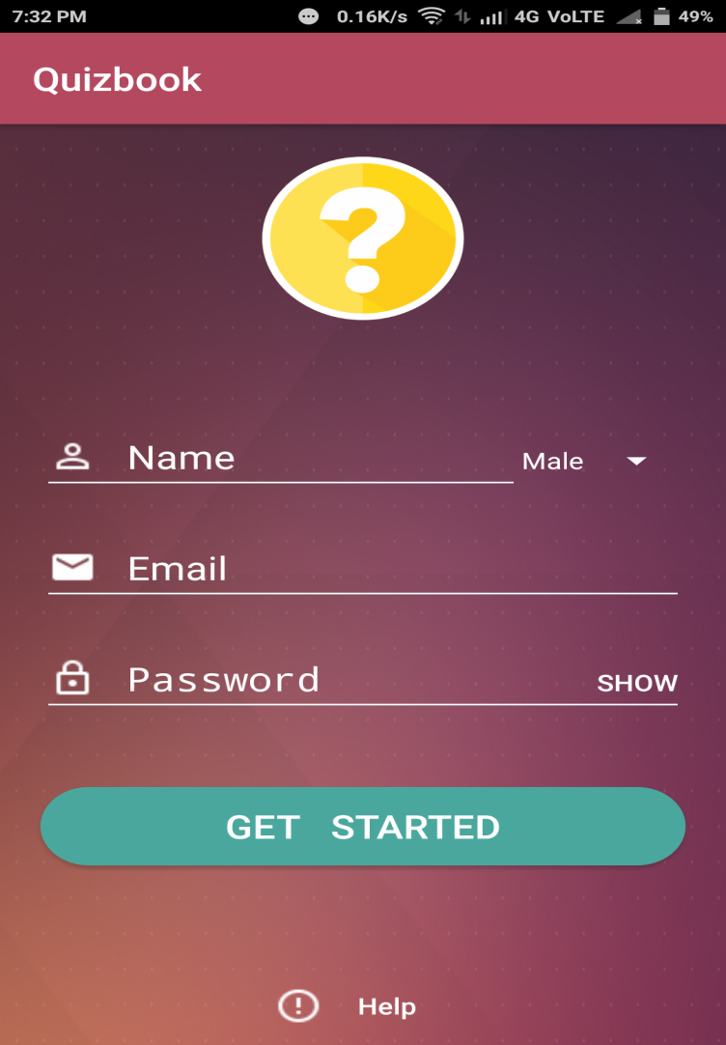
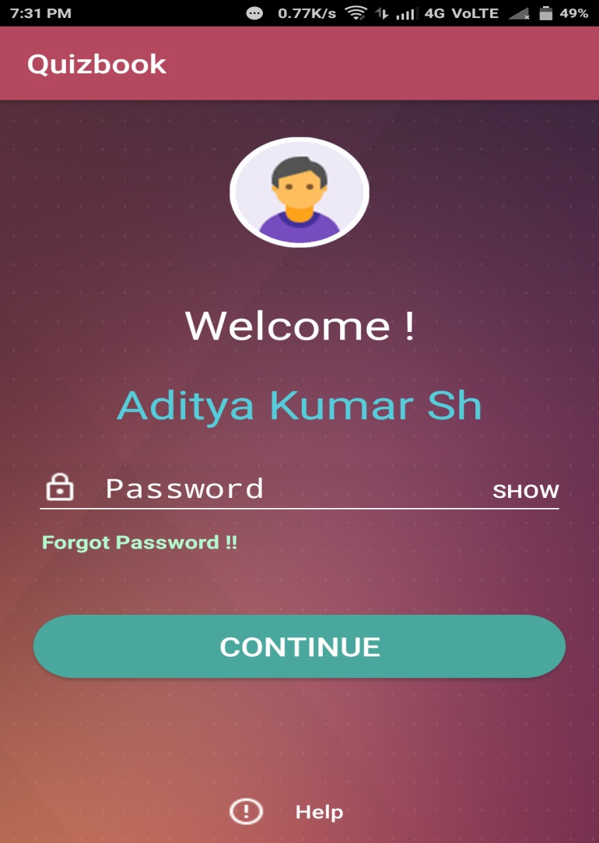
Screenshots of project
Registration Page
Login Page

Slide 19
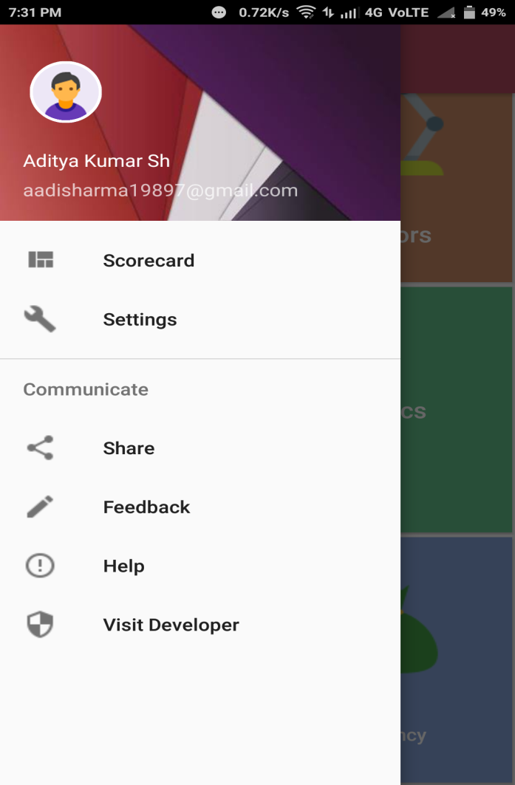
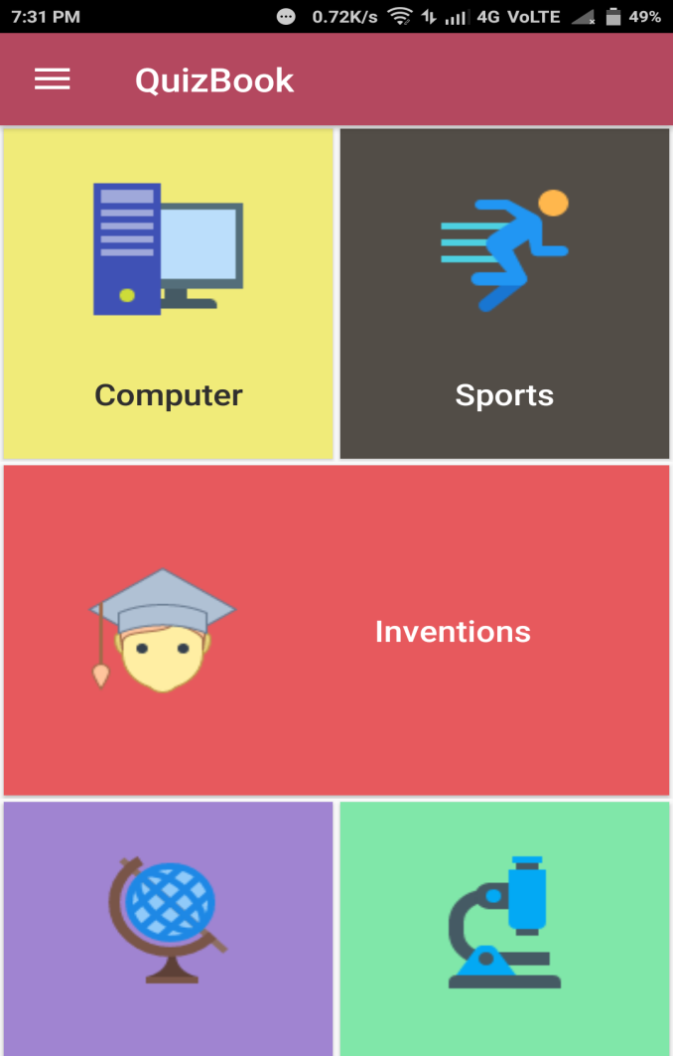
Screenshots of project
Profile Page
Test Module

Slide 20
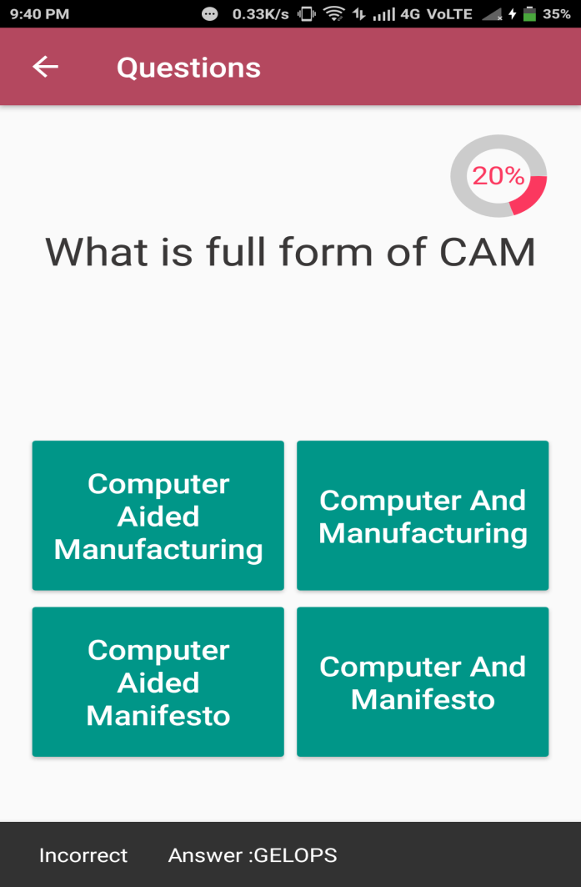
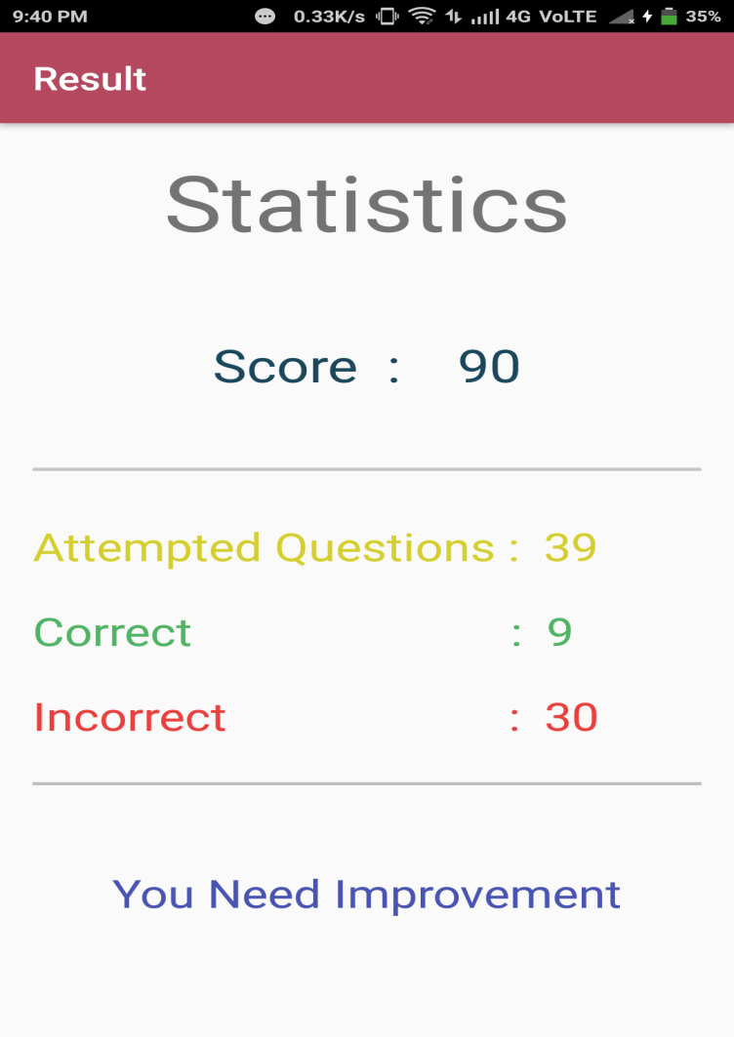
Screenshots of project
Test Pattern
Result

Slide 21
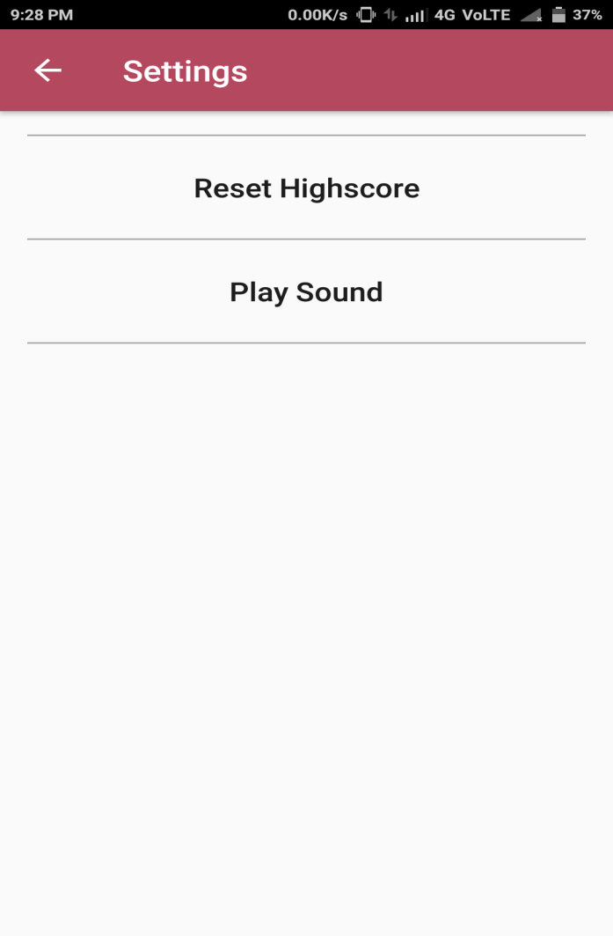
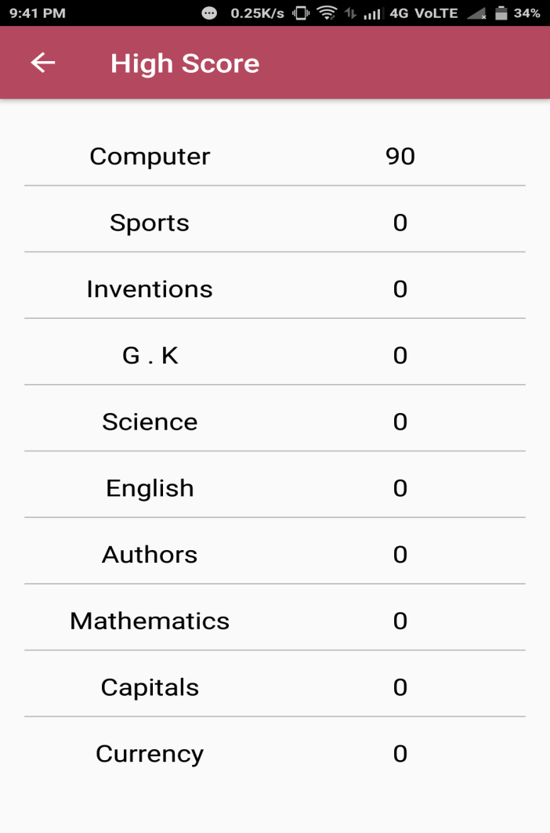
Screenshots of project
Setting Page
Reset score

Slide 22
Conclusion and Future Scope
In this application we can test our ability and knowledge . We can see that we need to improvement or not. Without opening books without need of paper work we can check our level of knowledge. we can access it anytime anywhere. it reduce the paper work.
We will make it for large level of exam like govt. Exam SSC, IES etc also provide the online test series for the students.

Slide 23

Thanks

